Slide 1
Accounting Principles, 7th Edition
Weygandt • Kieso • Kimmel
Chapter 15
CORPORATIONS: Dividends, Retained Earnings, and Income Reporting
Prepared by Naomi Karolinski
Monroe Community College
and
Marianne Bradford
Bryant College
John Wiley & Sons, Inc. © 2005

Slide 2
CHAPTER 15 CORPORATIONS: DIVIDENDS, RETAINED EARNINGS, AND INCOME REPORTING
After studying this chapter, you should be able to:
1 Prepare the entries for cash dividends and stock dividends.
2 Identify the items that are reported in a retained earnings statement.
3 Prepare and analyze a comprehensive stockholders’ equity section.
4 Describe the form and content of corporation income statements.
5 Compute earnings per share.

Slide 3
Dividends
STUDY OBJECTIVE 1
Distribution by a corporation to its stockholders on a pro rata (proportional) basis
May be in the form of cash, property, scrip (promissory note to pay cash), or stock
May be expressed in one of two ways:
  as a percentage of the par or stated value of the stock
  as a dollar amount per share

Slide 4

Cash Dividends
For a corporation to pay a cash dividend it must have:
(a) retained earnings
(b) adequate cash
(c) a declaration of dividends

Slide 5
Entries for Cash Dividends
Three important dates in connection with dividends:
Declaration date
Board of Directors formally declares a cash dividend and a liability is recorded.
Record date
Marks the time when ownership of outstanding shares is determined from the records maintained by the corporation.
Payment date
Date dividend checks are mailed to the stockholders and the payment of the dividend is recorded.
Notes:
Number me correctly

Slide 6
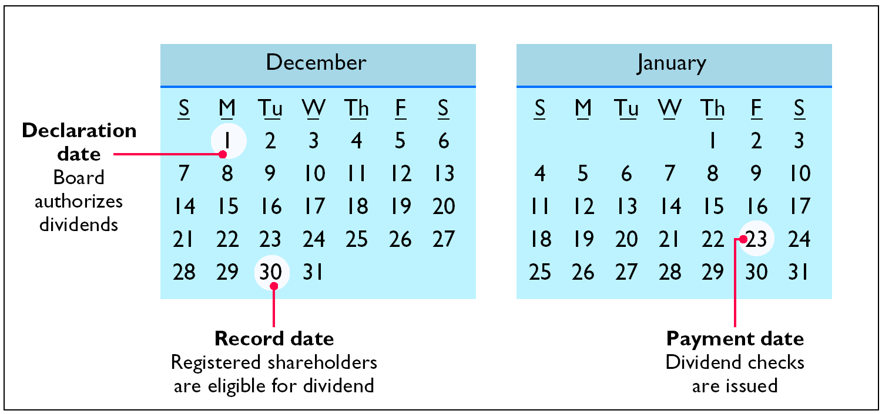
Key Dividend Dates

Slide 7

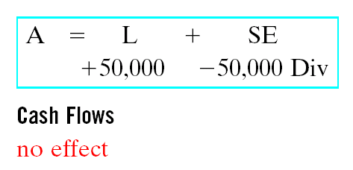
Declaration Date
Assume that on December 1, 2005, the directors of Media General declare a 50 cents per share cash dividend on 100,000 shares of $10 par value common stock. The dividend is $50,000 (100,000 x 50 cents) and the entry to record the declaration is:
Notes:
.

Slide 8
Record Date
The purpose of the record date is to identify the persons or entities that will receive the dividend, not to determine the dividend liability. For Media General, the record date is December 22. No entry is required on this date because the corporation’s liability recognized on the declaration date is unchanged.

Slide 9

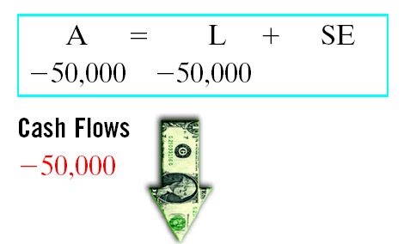
Payment Date
Assuming the payment date is January 20 for Media General, the entry on that date is:
Payment of the dividend REDUCES both current assets and current liabilities but has no effect on stockholders’ equity.

Slide 10
Allocating Cash Dividends Between Preferred and Common Stock
Cash dividends
  Must be paid first to preferred stockholders before
  any common stockholders are paid.
Cumulative preferred stock
  Any dividends in arrears and the current year dividend must be paid to preferred stockholders before allocating any dividends to common stockholders.
Preferred stock is not cumulative
  Only the current year’s dividend must be paid to preferred stockholders before paying any dividends to common stockholders.

Slide 11

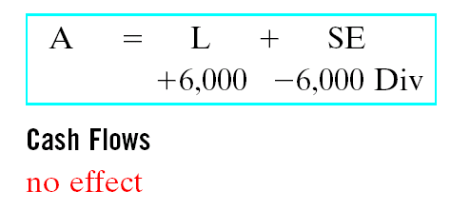
Allocating Cash Dividends Between Preferred and Common Stock
Assume that IBR Inc. has 1,000 shares of 8%, $100 par value
cumulative preferred stock and 50,000 shares of $10 par value
common stock outstanding at December 31, 2005. If the Board of Directors declares a $6,000 cash dividend on December 31, the entire $6,000 will go to preferred stockholders because their annual dividend is $8,000,(1,000 shares x $8) .
$2,000 has gone
into arrears for
preferred
stockholders

Slide 12
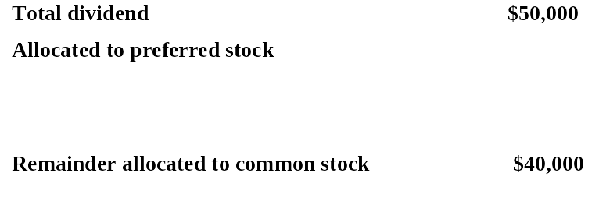
Allocating Cash Dividends Between Preferred and Common Stock
Dividend in arrears, 2005 (1,000 x $2) $2,000
2006 dividend (1,000 x $8) 8,000 10,000
At December 31, 2005, IBR declares a $50,000 cash dividend.
The allocation of the dividend to the two classes of stock is
shown above.If the preferred stock was NON-cumulative,
preferred stockholders would have received only $8,000 in
dividends in 2006 and common stockholders would have
received $42,000.

Slide 13
The date a cash dividend becomes a binding legal obligation to a corporation is the
a. declaration date.
b. earnings date.
c. payment date.
d. record date.
Chapter 15

Slide 14
The date a cash dividend becomes a binding legal obligation to a corporation is the
a. declaration date.
b. earnings date.
c. payment date.
d. record date.
Chapter 15

Slide 15

Stock Dividends
Pro rata distribution to stockholders of the corporation’s own stock
  results in a decrease in retained earnings and an increase in paid-in capital
  at a minimum, the par or stated value must be assigned to the dividend shares; in most cases, however, fair market value is used
A stock dividend does NOT decrease Total Assets or Total Stockholders’ Equity.

Slide 16
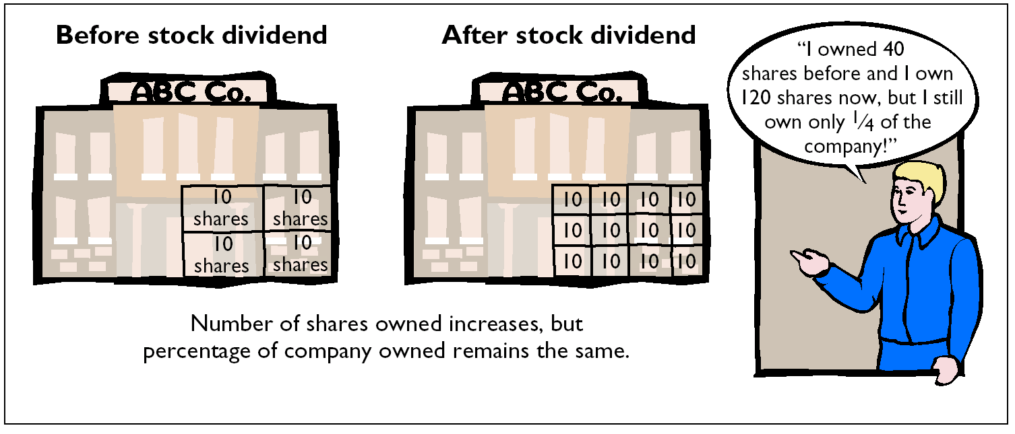
Stock Dividends

Slide 17
Disclosure
Rally would present the information in the following
Format.
Rally Inc.
Income Statement (partial)
Net income $211,000
Earnings per share $2.00

Slide 18
Earnings per Share
The formula to compute earnings per share when there is no preferred stock is as follows:
Weighted
Average
Common
Shares
Outstanding
Net
Income
/
Earnings
per
Share

Slide 19

Purposes and Benefits of a Stock Dividend
Corporations issue stock dividends generally for one or more of the following reasons:
1)To satisfy stockholders’ dividend expectations without spending cash
2)To increase the marketability of stock by increasing the number of shares
3)To emphasize that a portion of stockholders’ equity has been permanently reinvested in the business and unavailable for cash dividends

Slide 20

Stock Dividends Distinguished
SMALL stock dividend
  less than 20-25% of the corporation’s issued stock
  assign fair market value to SMALL stock dividends
    assumption that a small stock dividend will have little effect on the market price of the shares previously outstanding.
LARGE stock dividend
  greater than 20-25% of the corporation’s issued stock
  par or stated value per share is normally assigned

Slide 21

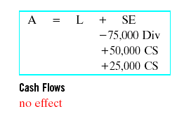
Entries for Stock Dividends
Assume that Medland Corporation has a balance of $300,000 in retained
earnings and declares a 10% stock dividend on its 50,000 shares of $10 par
value common stock. The current fair value of its stock is $15 per share
and the number of shares to be issued is 5,000 (10% of 50,000). The amount to be debited to Retained Earnings is $75,000 (5,000 x $15).
NOTE !
Retained Earnings is debited for the fair market value of the stock issued because this is a SMALL stock dividend. Common Stock Dividends Distributable is credited for the par value of the dividend shares (5,000 x $10), and the excess is credited to Paid-in Capital.
Notes:
Can’t get rid of Green Change the dollar amount on the green.

Slide 22

Statement Presentation of Common Stock Dividends Distributable
Common Stock Dividends Distributable is a stockholders’ equity account; it is not a liability because assets will NOT be used to pay the dividend. If a balance sheet is prepared before the dividend shares are issued, the distributable account is reported in paid-in capital as an addition to common stock.
$ 500,000 50,000 $550,000
When the dividend shares are issued, Common
Stock Dividends Distributable is debited and Common Stock is credited.

Slide 23
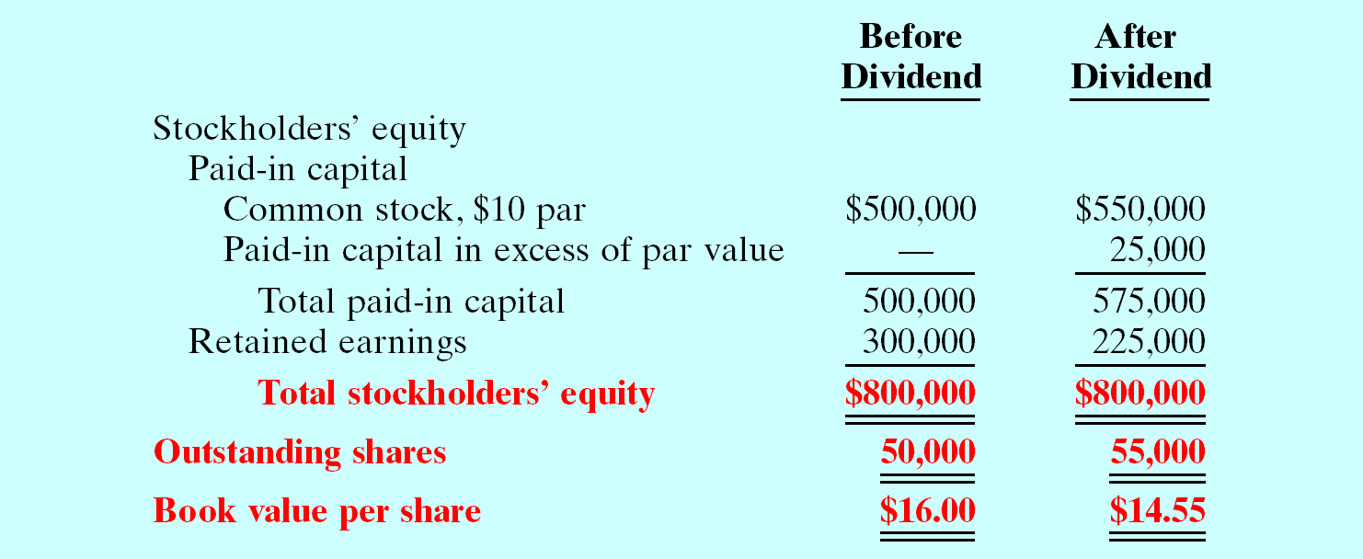
Stock Dividend Effects
Stock dividends change the composition of stockholders’ equity because a portion of retained earnings is transferred to paid-in capital. However, total stockholders’ equity and the par or stated value per share remain the same.

Slide 24

Stock Splits
The issuance of additional shares to stockholders according to their percentage ownership
  number of shares increased in the same proportion that par or stated value per share is decreased
Has no effect on total paid-in capital, retained earnings, and total stockholders’ equity.
Not necessary to formally journalize a stock split

Slide 25
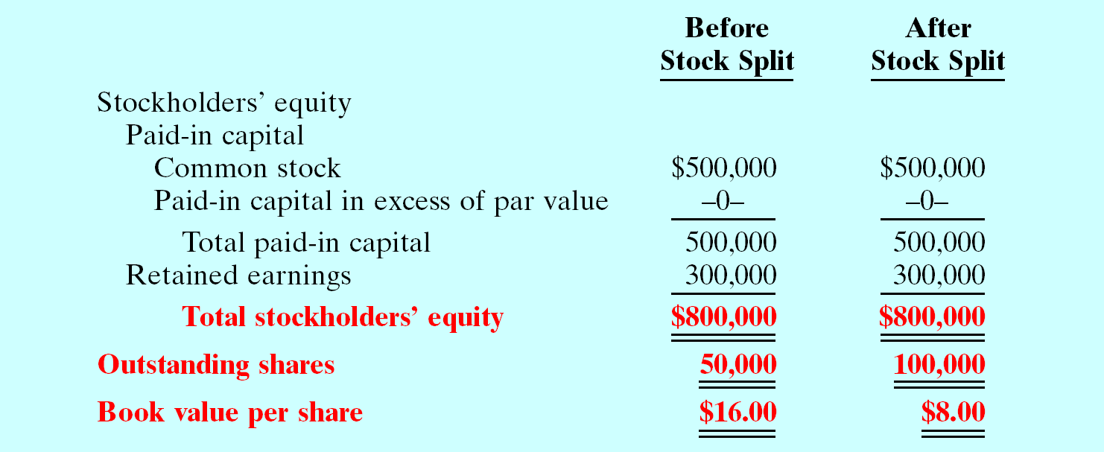
Stock Split Effects
Assume instead of a 10% dividend, Medland Corporation splits its 50,000 shares of common stock on a 2-for-1 basis. This means that one share of $10 par value stock is exchanged for two shares of $5 par value stock. A stock split DOES NOT have any effect on total paid-in capital, retained earnings, and total stockholders’ equity. However, number of shares increases and book value per share decreases.

Slide 26
Differences Between the Effects of Stock Splits and Stock Dividends
Item
Stock Split
Stock Dividend
Total paid-in capital
No change
Increase
Total retained earnings
No change
Decrease
Total par value (common
No change
Increase
stock)
Par value per share
Decrease
No change

Slide 27

Retained Earnings
STUDY OBJECTIVE 2
Net income retained in the business.
Balance in retained earnings is part of the stockholders’ claim on the total assets of the corporation.
  A net loss is recorded in Retained Earnings by a closing entry in which Retained Earnings is debited and Income Summary is credited.

Slide 28
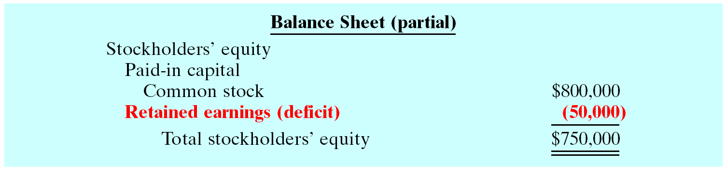
Stockholders’ Equity with Deficit
A debit balance in retained earnings is identified as
a DEFICIT. It is reported as a deduction in the
stockholders’ equity section, as shown above.

Slide 29
Retained Earnings Restrictions
Portion of the balance currently unavailable for dividends.
1) Legal
states may require that corporations restrict RE for the cost of treasury stock purchased.
2) Contractual
long term debt contracts may restrict RE as a condition for a loan.
3) Voluntary
the Board of Directors may voluntarily restrict RE for specific purposes such as future plant expansion.

Slide 30

Disclosure of Unrestricted Retained Earnings
The balance in retained earnings is generally available for dividend declarations. Some companies state this fact.
In the notes to its financial statements, Martin Lockheed Corporation states:

Slide 31
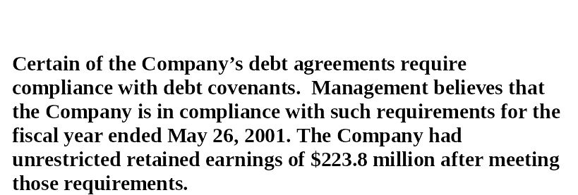
Disclosure of Restriction
Tektronix Inc.
Notes to the Financial Statements
Retained earnings restrictions are generally disclosed in the notes to the financial statements. For example, Tektronix had the above note in a recent financial statement.

Slide 32

Prior Period Adjustments
Correction of a material error in reporting net income in a previously issued financial statement.
  1) made directly to Retained Earnings.
  2) reported in the current year’s retained earnings statement as an adjustment of the beginning balance of Retained Earnings.

Slide 33
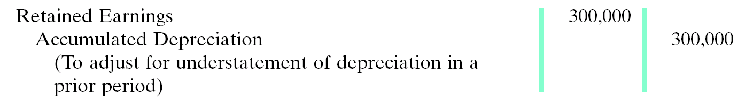
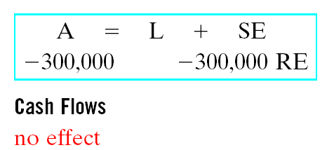
Prior Period Adjustments
Assume that General Microwave discovers in 2005 that it understated
depreciation expense in 2004 by $300,000 as a result of computational
errors. These errors overstated net income for 2004, and the current
balance in retained earnings is also overstated. The entry for the prior
period adjustment, assuming all tax effects are ignored, is as follows:
NOTE !
A DEBIT TO AN INCOME STATEMENT ACCOUNT IN 2005 WOULD BE
INCORRECT BECAUSE THE ERROR PERTAINS TO A PRIOR PERIOD

Slide 34
Statement Presentation of Prior Period Adjustments
Assuming that General Microwave has a beginning balance of $800,000 in retained earnings, the prior period adjustment is reported as follows:
GENERAL MICROWAVE
Retained Earnings Statement (partial)
Balance, January 1, as reported
$800,000
Correction for overstatement of net income
in prior period (depreciation error) (300,000)
Balance, January 1, as adjusted
$500,000
NOTE !
REPORTING THE CORRECTION IN THE CURRENT YEAR’S INCOME STATEMENT WOULD BE INCORRECT BECAUSE IT APPLIES TO A PRIOR YEAR’S INCOME STATEMENT.

Slide 35
Debits and Credits to
Retained Earnings
Retained Earnings
1.Net Loss 2.Prior period adjustments for
overstatement of net income
3.Cash dividends and stock
dividends
4.Some disposals of treasury
stock
Net income
Prior period adjustment for
understatement of net income
Many corporations prepare a retained earnings statement to explain the changes in retained earnings during the year.

Slide 36
Comprehensive Stockholders’ Equity Section
STUDY OBJECTIVE 3
Common Stock Dividends Distributable
  shown under capital stock in paid-in-capital
Retained Earnings restrictions
  disclosed in the notes to the financial statements

Slide 37

Corporation Income Statements
STUDY OBJECTIVE 4
Includes essentially the same sections as in a proprietorship or a partnership except for the reporting of income taxes
For tax purposes, corporations are considered to be a separate legal entity.
Income tax expense
  Reported in a separate section of the corporation income statement before net income

Slide 38
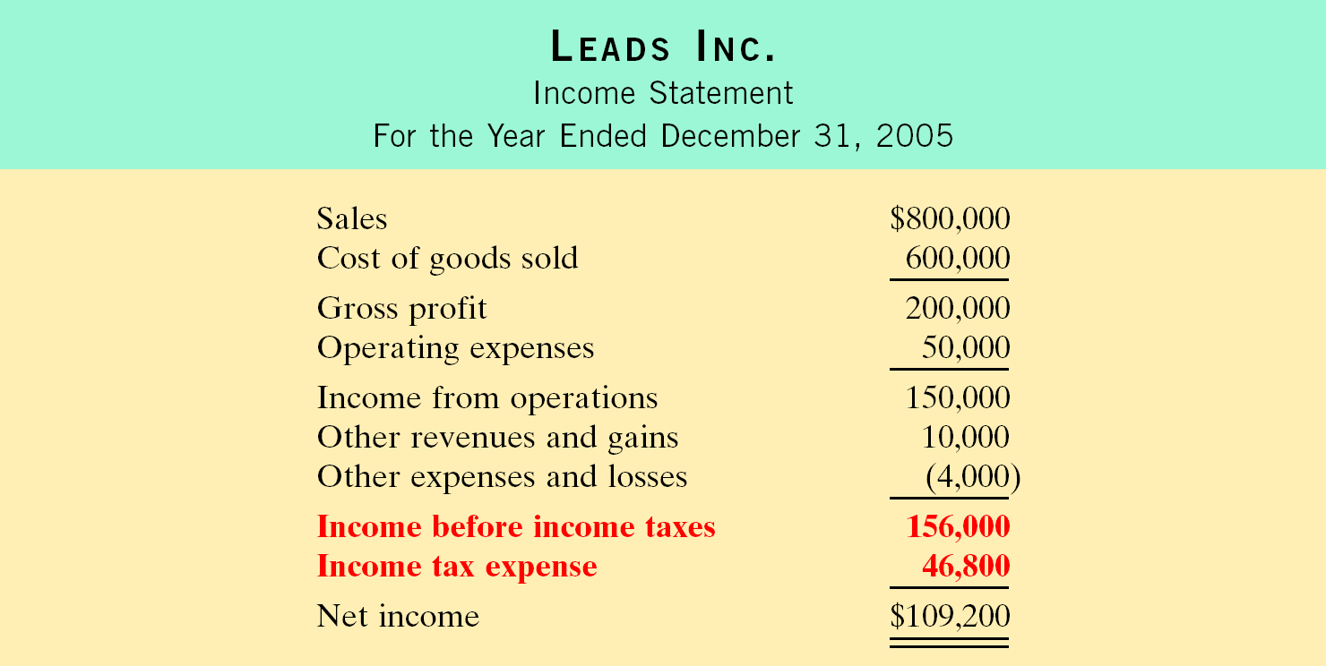
Income Statement with Income Taxes

Slide 39
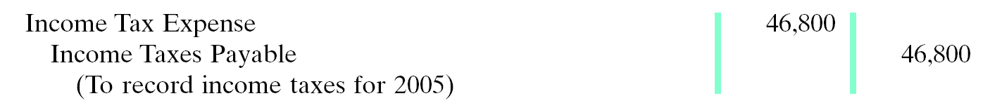
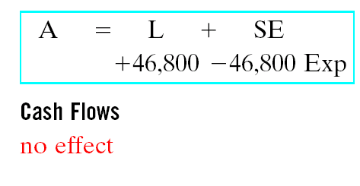
Income Tax Expense
Using the preceding Income Statement, the adjusting entry for income tax expense at December 31, 2005, would be as follows:

Slide 40
Earnings per Share
Study Objective 5
Frequently reported in the financial press
Used by stockholders and investors to evaluate profitability
Indicates the net income earned by each share of outstanding common stock

Slide 41
EPS and Preferred Stock Dividends
When a corporation has both preferred and common stock, the current year’s dividend declared on preferred stock is subtracted from net income to arrive at income available to common stockholders. Assume that Rally Inc. reports net income of $211,000 on its 102,500 weighted average common shares. During the year it also declares a $6,000 dividend on its preferred stock.
Net Income
Minus
Preferred
Dividends
Weighted
Average
of Common
Shares
Outstanding
/
Earnings
per
Share
($211,000 - $6,000) / 102,500 = $2 EPS
Therefore, Rally has $205,000 ($211,000 - $6,000) available for common stock dividends. EPS is $2 ($205,000 / 102,500).

Slide 42
The income statement for Nadeen, Inc. shows income before income taxes $700,000, income tax expense $210,000, and net income $490,000. If Nadeen has 100,000 shares of common stock outstanding throughout the year, earnings per share is:
a. $7.00.
b. $4.90.
c. $2.10.
d. No correct answer is given.
Chapter 15

Slide 43
The income statement for Nadeen, Inc. shows income before income taxes $700,000, income tax expense $210,000, and net income $490,000. If Nadeen has 100,000 shares of common stock outstanding throughout the year, earnings per share is:
a. $7.00.
b. $4.90.
c. $2.10.
d. No correct answer is given.
Chapter 15

Slide 44

CHAPTER 15
Corporations: Dividends, Retained
Earnings, and Income Reporting
Copyright © 2005 John Wiley & Sons, Inc. All rights reserved. Reproduction or translation of this work beyond that permitted in Section 117 of the 1976 United States Copyright Act without the express written consent of the copyright owner is unlawful. Request for further information should be addressed to the Permissions Department, John Wiley & Sons, Inc. The purchaser may make back-up copies for his/her own use only and not for distribution or resale. The Publisher assumes no responsibility for errors, omissions, or damages, caused by the use of these programs or from the use of the information contained herein.

